Slide 1
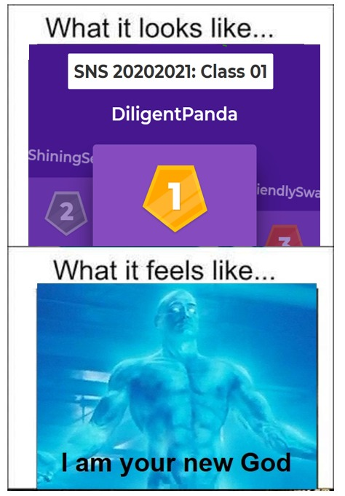

Ikbel
Ikbel
Lorenzo
Lorenzo
Alba
Alba

Slide 2
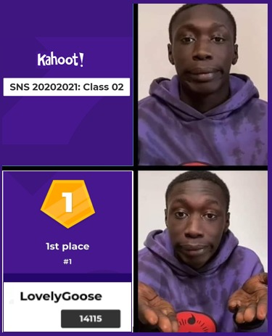
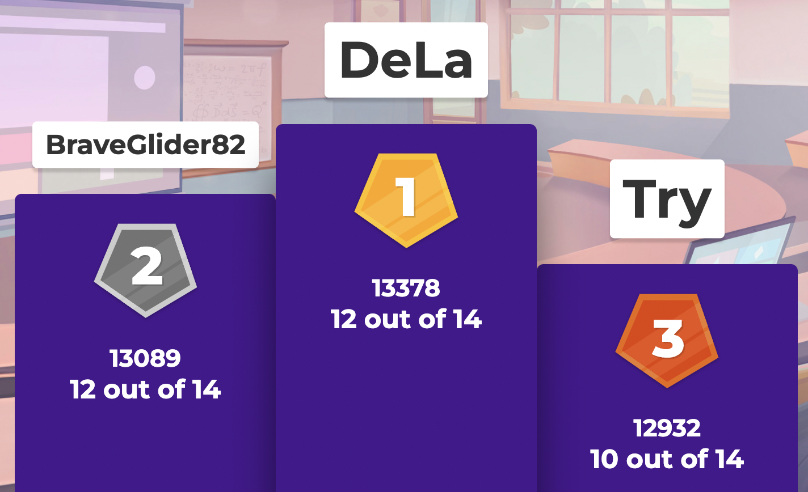
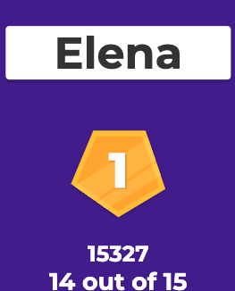
No, ho usato solo podio e poco altro
Non ricordo. Non questo
USER

Slide 3
No, ho usato solo podio e poco altro
Non ricordo. Non questo
USER

Slide 4
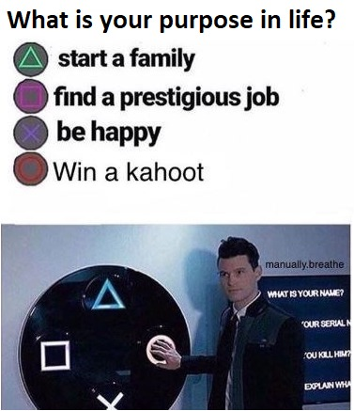
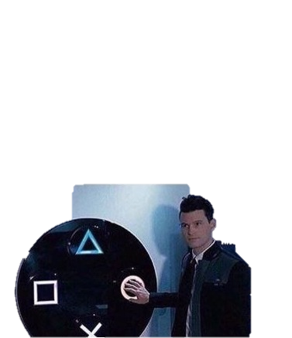
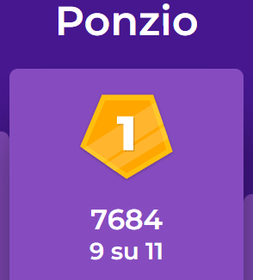
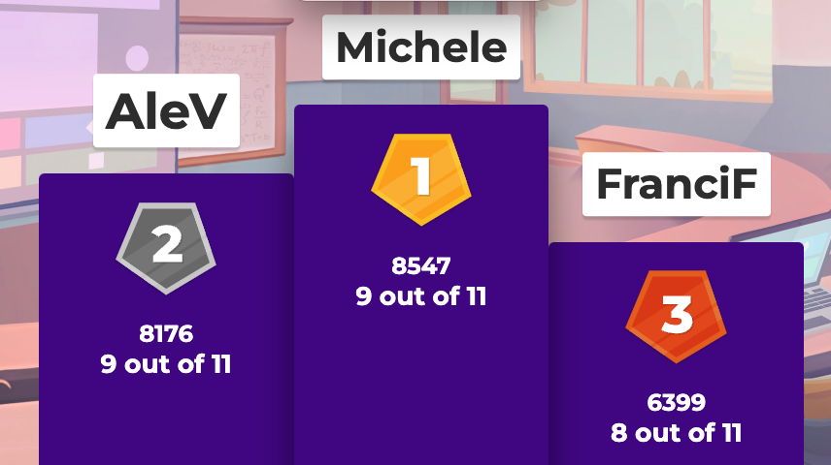
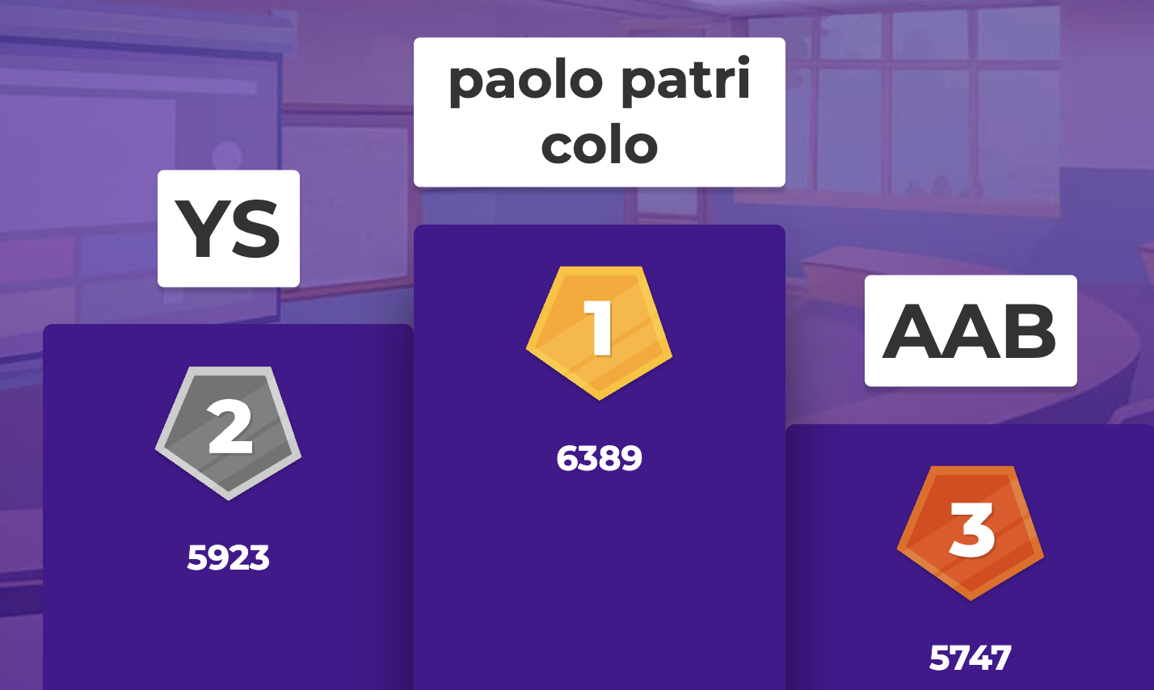
paolo
patricolo
Elena.s

Slide 5
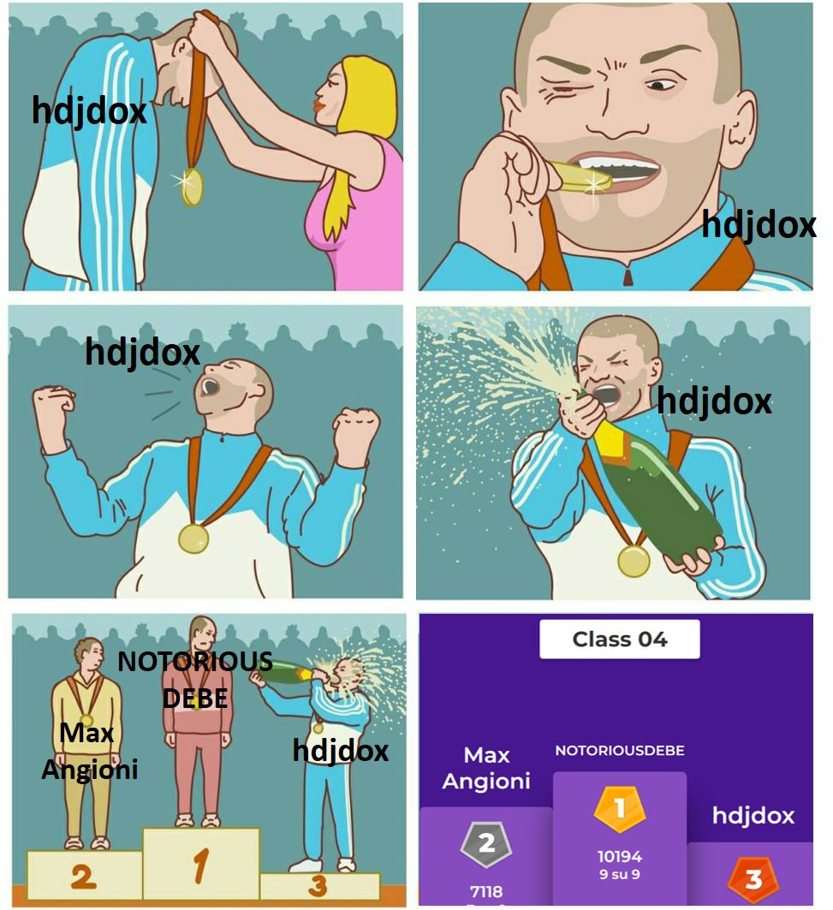
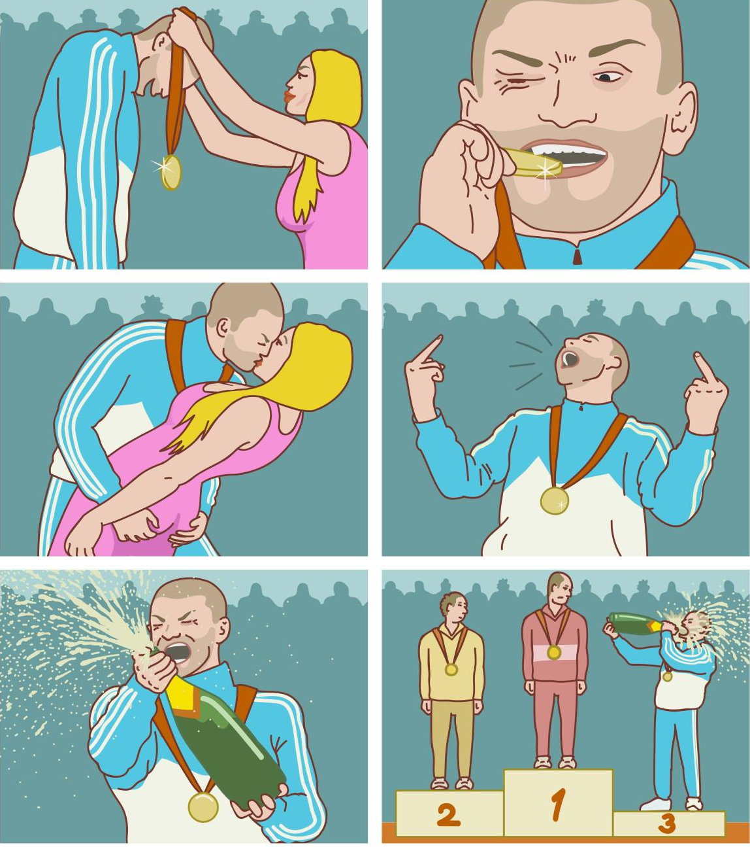
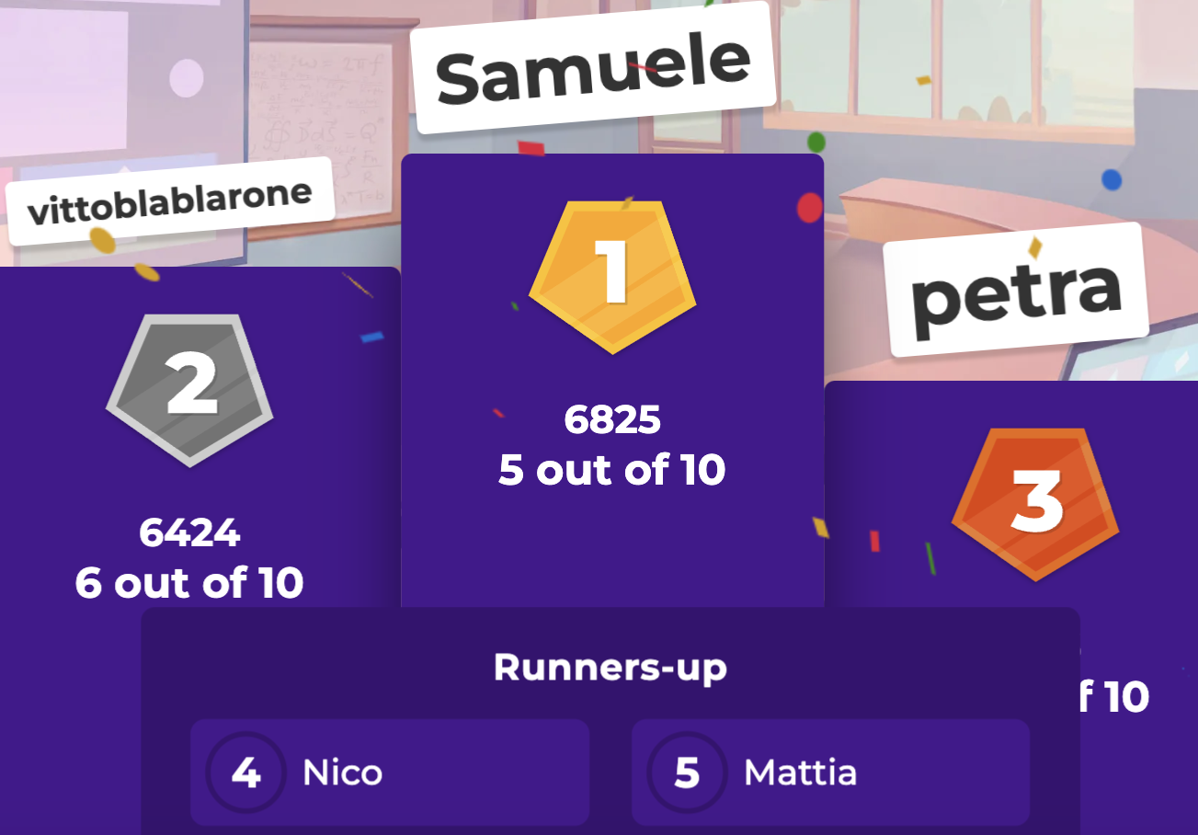
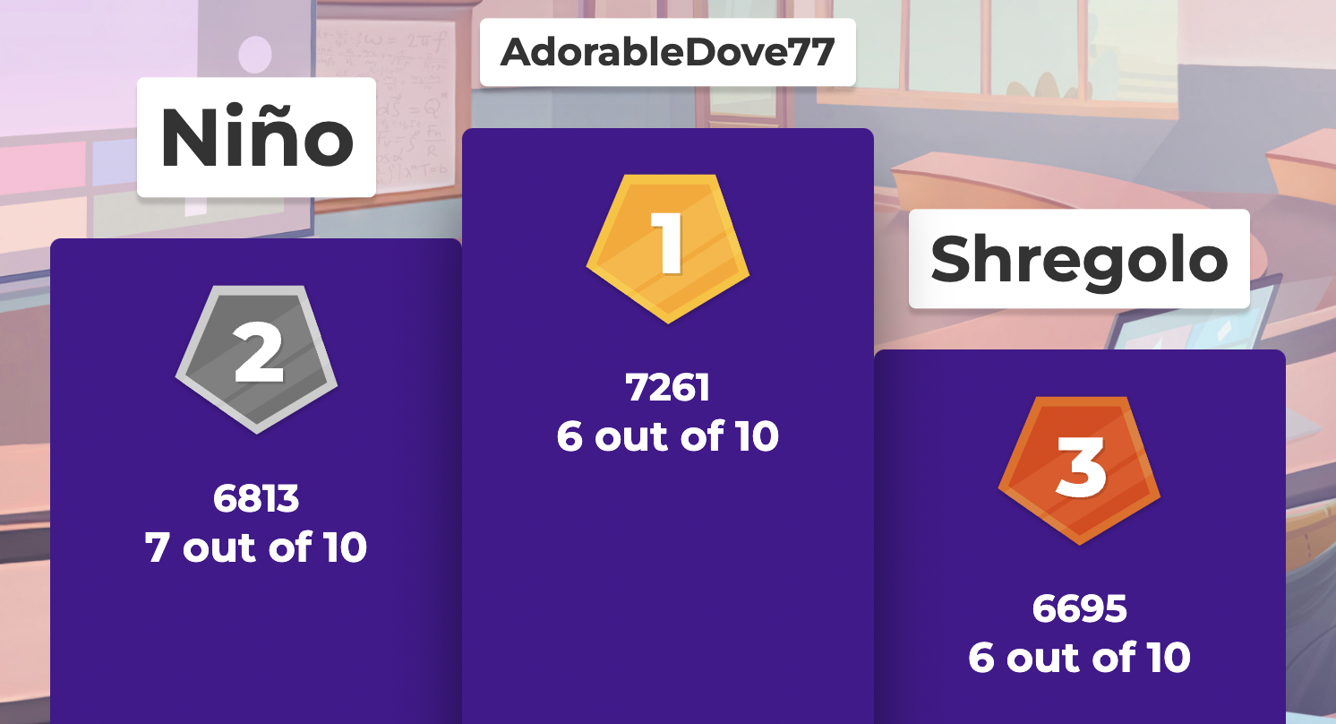
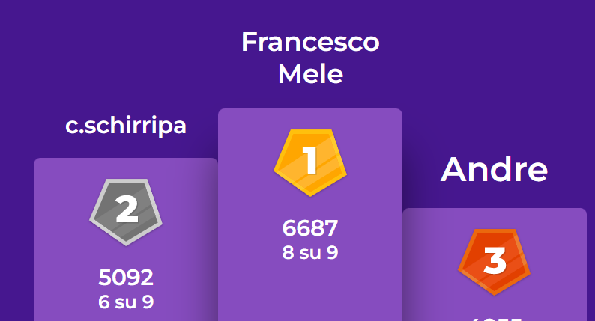
Petra
Petra
Petra
Petra
PUT PODIUM

Slide 6
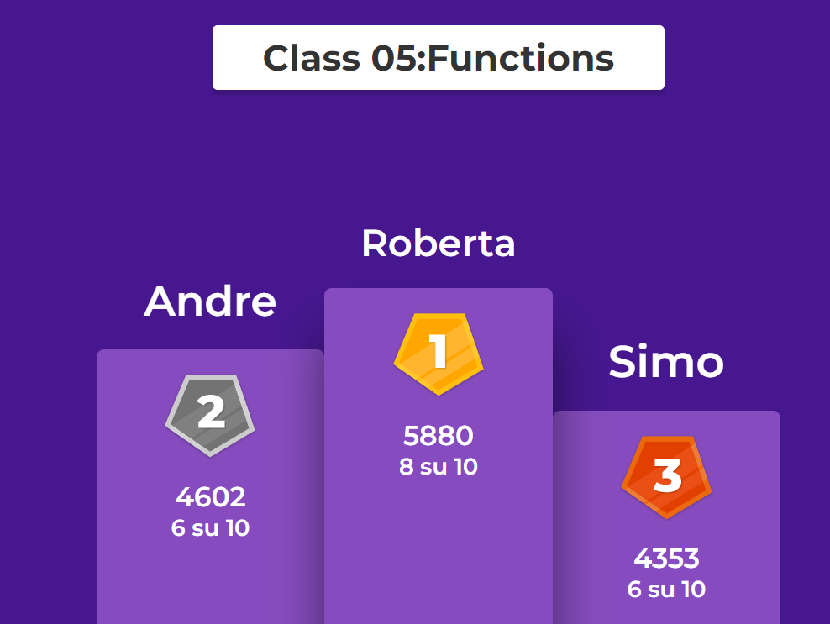
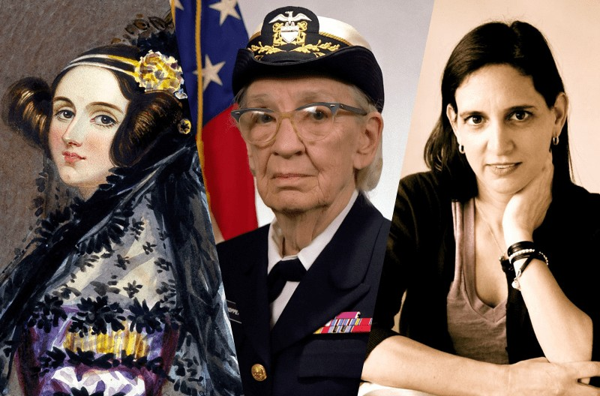

IF winner is a woman
Computing's unknown Heroes
Kahoot Class4
Kahoot Class5
ELENA

Slide 7
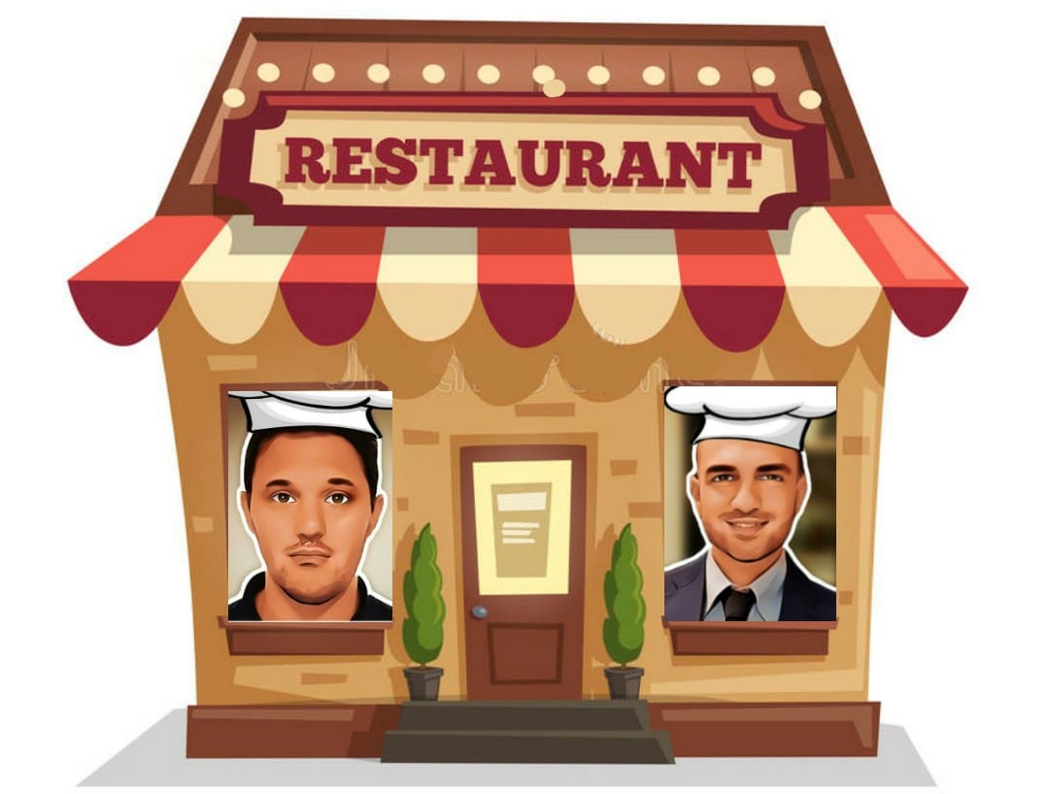
IF winner is a man
Computing's unknown Heroes
CLASS 6, CLASS 7
LEO

Slide 8
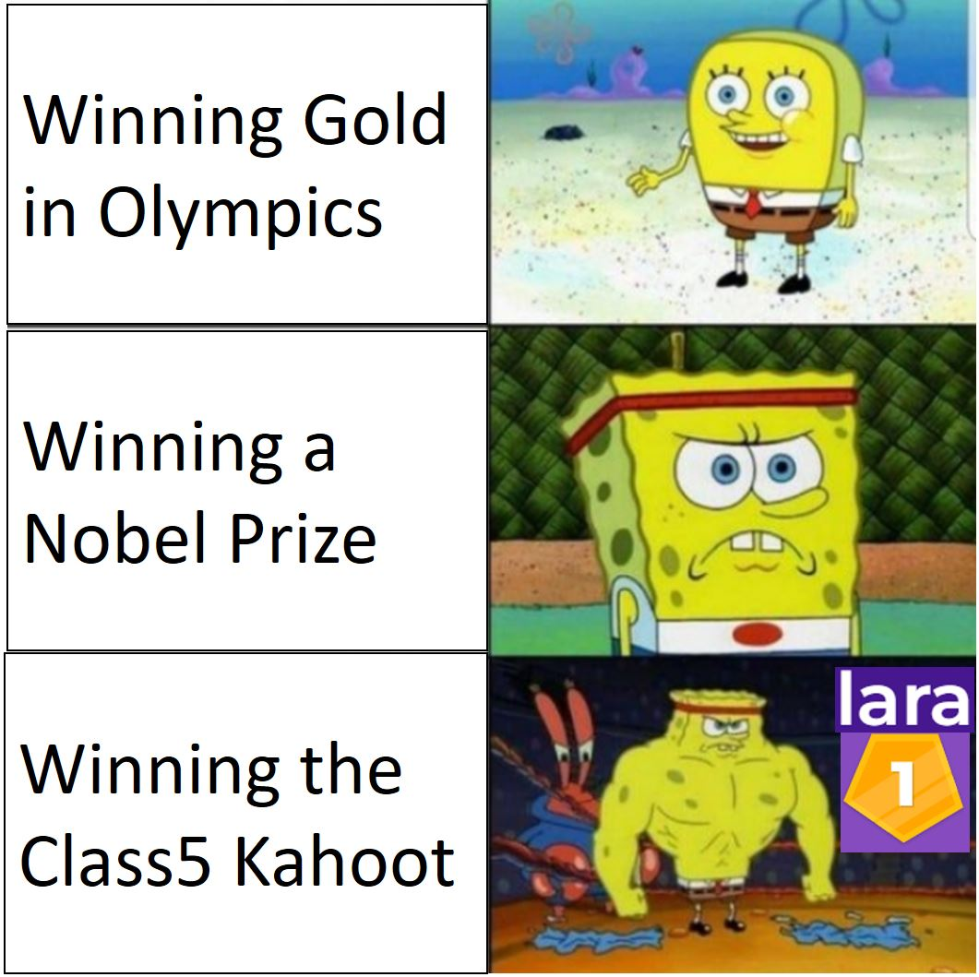
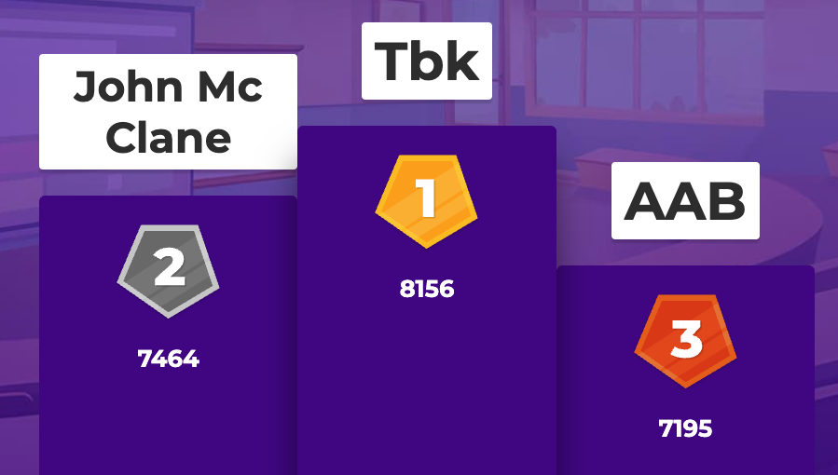
Tbk
5

Slide 9
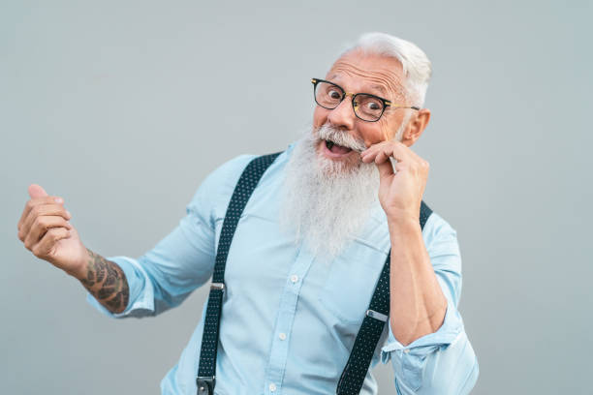
“Assignments are not stressful at all"
Pietro, Ex PDAI Student, 24 years old

Slide 10
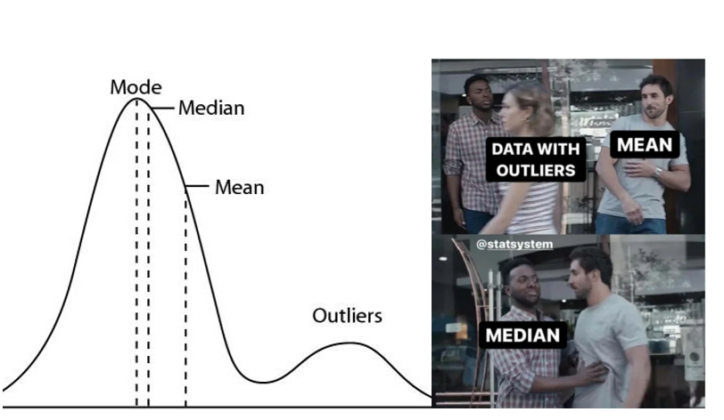

Slide 11
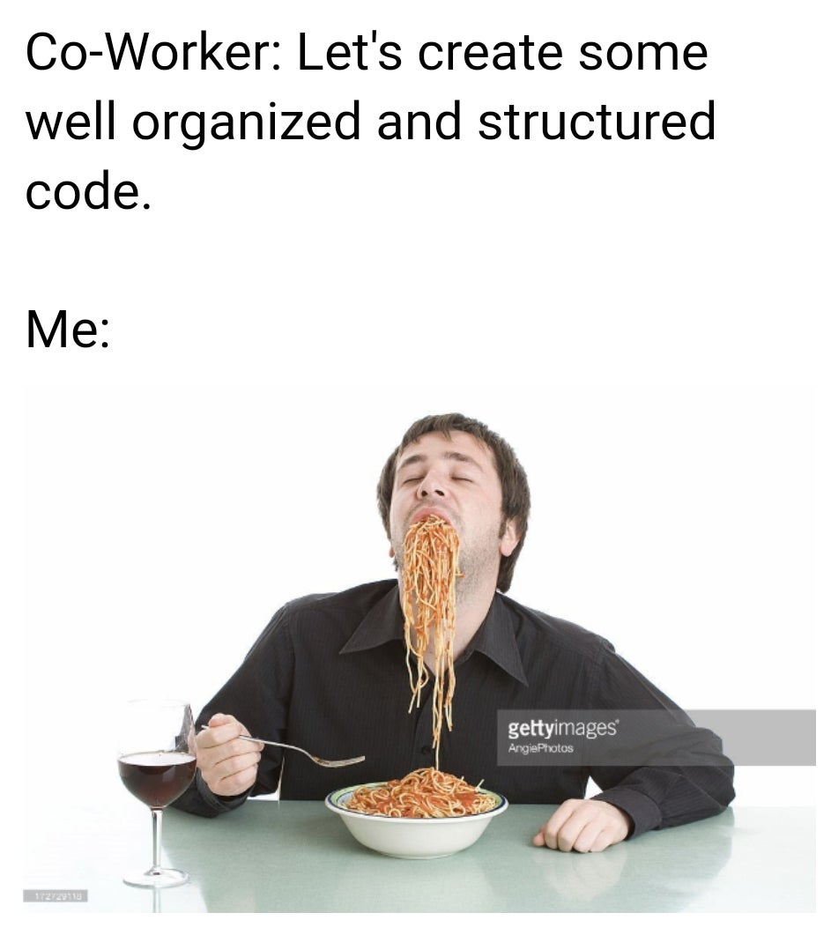
Professor: After lesson 5 you can create well-organized and structured code.
Notes:
Professor: After lesson 5 you can create some well organized and structured code.

Slide 12
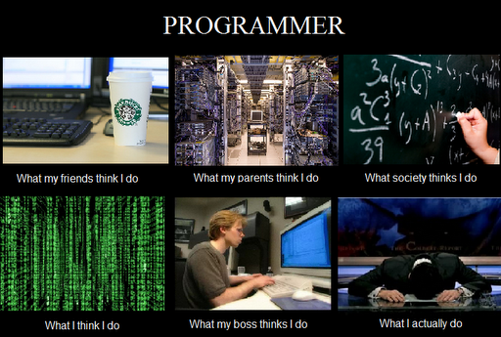
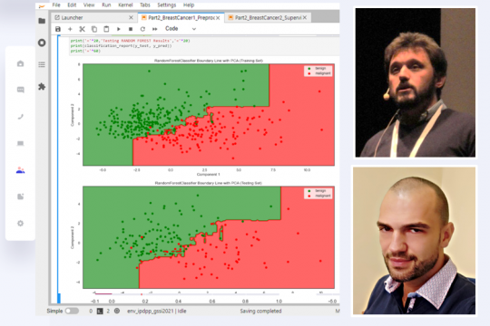
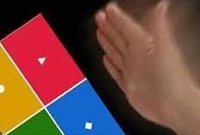
INTRODUCTION TO PROGRAMMING
AND DATA PROCESSING
What my friends think I do What my parents think I do What society thinks I do
What I think I do What my teachers think I do What I actually do

